Slide 1
Can we assess research culture responsibly? Reflections from the REF PCE indicators project
Dr Yolana Pringle Director & Deputy CEO, CRAC-Vitae
Vitae and its membership programme are managed by the Careers Research and Advisory Centre (CRAC) Limited, an independent registered charity.
Vitae, © The Careers Research and Advisory Centre (CRAC) Limited.
https://vitae.ac.uk/

Slide 2
What is REF PCE?

Slide 3
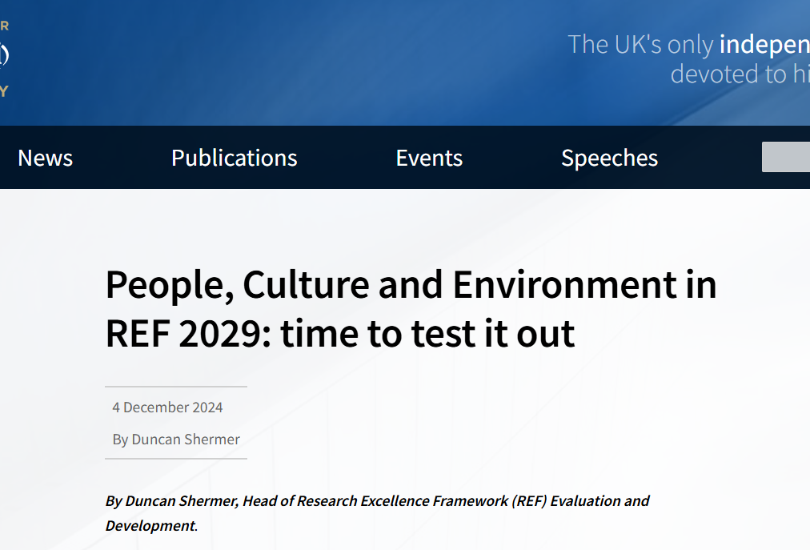
Journey to REF PCE 2029
PCE indicators project and announcement of PCE pilot
REF PCE pilot exercise
Initial decisions and consultation
Publication of final guidance and criteria
REF team and panels co-develop PCE criteria and guidance; further consultation
Jan 2024
Autumn 2025
June 2023
Nov 2024
Early 2026

Slide 4
REF PCE indicators project
Technopolis UK and Vitae, with a range of sector partners
The overarching aims were:
to develop a set of indicators that may be used by institutions to evidence PCE
produce a draft submission template for PCE
put forward recommendations on their use to the joint funding bodies.

Slide 5
Sector priorities for research culture
Themes that came through strongly
Equality, diversity and inclusion | Research integrity and reproducibility
Openness and open research | Collaboration
Recognition
Mental health and wellbeing
Time as a cross-cutting issue

Slide 6
Insights from the sector workshops
Strategy
Inclusivity
Development
Responsibility
Connectivity
PCE enablers
Broad, flexible approach to research culture
Two core purposes for assessing PCE in REF:
To incentivise institutions
To reward progress within institutions
Indicators that reward commitment, efficacy, relevance, and shared learning not money

Slide 7
Tensions in assessing research culture responsibly
Limited and inconsistent data across institutions
Challenges with survey data – validity, comparisons, response burden
Narrative burden vs meaningful reflection
Tension between standardisation and institutional nuance
Risk that indicators become tick-box exercises

